Slide 1
June 2103

Slide 2
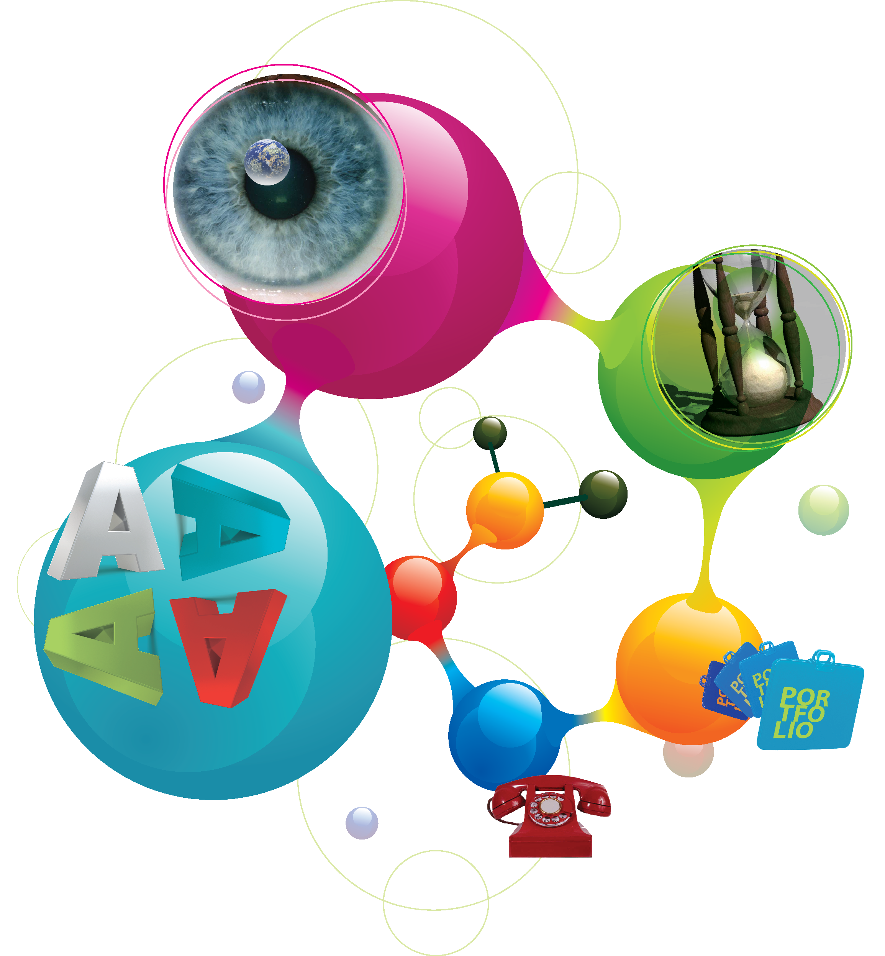
contents
under the
microscope
assignment
timeline
the 4A’s effect
assessment
aspiration
aesthetic
application
our Work
contact

Slide 3
under the microscope
The foundation of a brand determines its success. By understanding exactly what a brand is composed of we ensure that it receives the suitable and adequate dosage of handling to thrive in any market.
DNA Branding Solutions doesn’t just manage a brand. We delve into the very structural make-up of a brand, dissecting it to its absolute core and sourcing that key gene that sets each brand apart – its unique genetic code.
Only then can we begin treating and building a brand to its optimal prime.

Slide 4
the 4A’s effect
This world revolves around everything primary.
First place, podium finishes…
no one cares for what follows.
The same is said about brands. People respond to the biggest and best and to get to that number 1 position you need an approach that is borne from
4A’s thinking.

Slide 5
our branding approach
application
aesthetic
aspiration
assessment

Slide 6
the 4A’s approach
assessment
aspiration
aesthetic
application
Brand and Service
Information
Research
Brand Dynamics
Category Drivers
Competition
Stakeholders
Consumers
Brand Mapping
Brand Edge
Brand Positioning
Brand Architecture
Brand Key
Messaging
Brand Identity
Brand Look
Brand Tone
Brand Guidelines
Collaterals
Deliverables &
Solutions
Brand Activation

Slide 7
assessment
research
Examining the known and discovering the unknown.
The first step to any branding operation is preparation. Only by knowing every detail of a brand, the market and its competitors can we effectively prescribe specialised branding solutions that make sense.

Slide 8
aspiration
insight
It’s that key feature that is identified from our extensive research that then becomes the driving force behind brand development and thereafter brand management thereby aiding brands in achieving their goals.

Slide 9
aesthetic
identity
A brand’s appearance tells a lot about its operation. From the logo & slogan to the visual identity and overall design appeal to stand out through the masses of identities, colours and patterns a brand need the right look before it starts making the right moves.

Slide 10
application
treatment
A culmination of the entire process into a single strategic and creatively sound brand architecture that resets the internal make-up of brand allowing it to get further, grow taller and leave its thumbprint wherever it pleases.

Slide 11
popular approach to branding architecture
fixed
endorsed
OR
umbrella
branding
flexible
endorsed
OR
sub-
branding
monolithic
OR
uni-
branding
discreet
OR
multi-
branding
one brand only
company
some sub brands
but look the same
separate names some link but brand in its own right
many brands not related and not connected to
parent company
A3
SC Johnson
P&G
Ford
A6
Audi
A4
RAID
A5
Focus
Explorer
Mustang
RAID Natural
Pantene
Pampers
Head & Shoulders
Virgin
Sony, Microsoft
Nestle/ Kit Kat
GM, Pepsi, Unilever

Slide 12
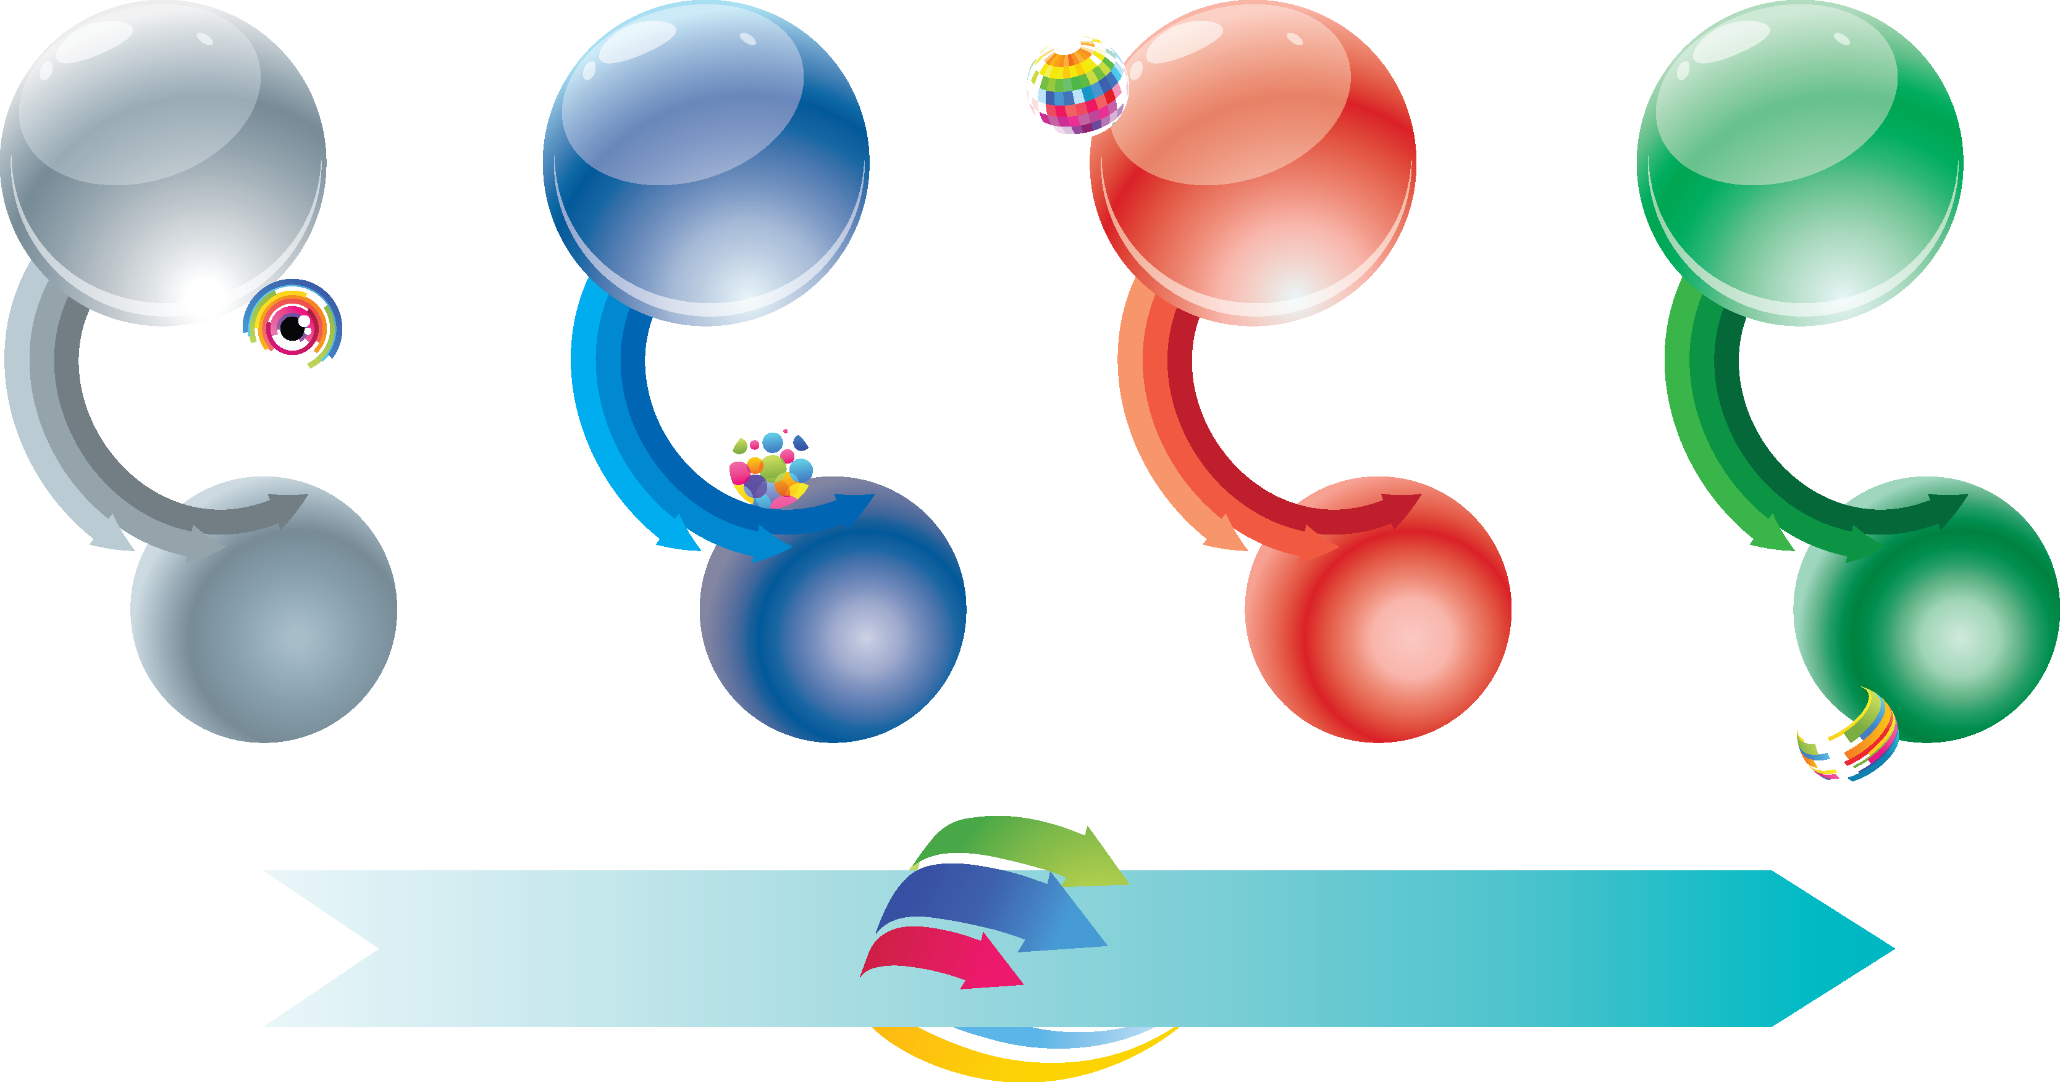
project timeline
phase 1
assessment
phase 2
aspiration
phase 3
aesthetic
phase 4
application
2 weeks
2 weeks
4 weeks
4 weeks
12 weeks
12 weeks

Slide 13
our work

Slide 14
c.i. standards
al ain zoo & sub-brands

Slide 16
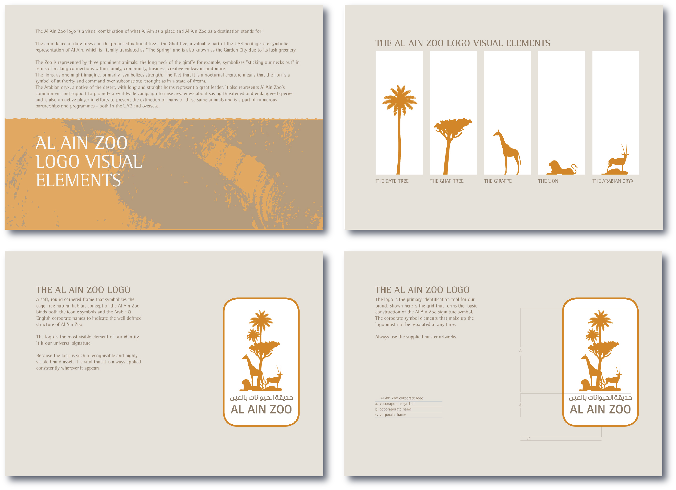

Slide 18
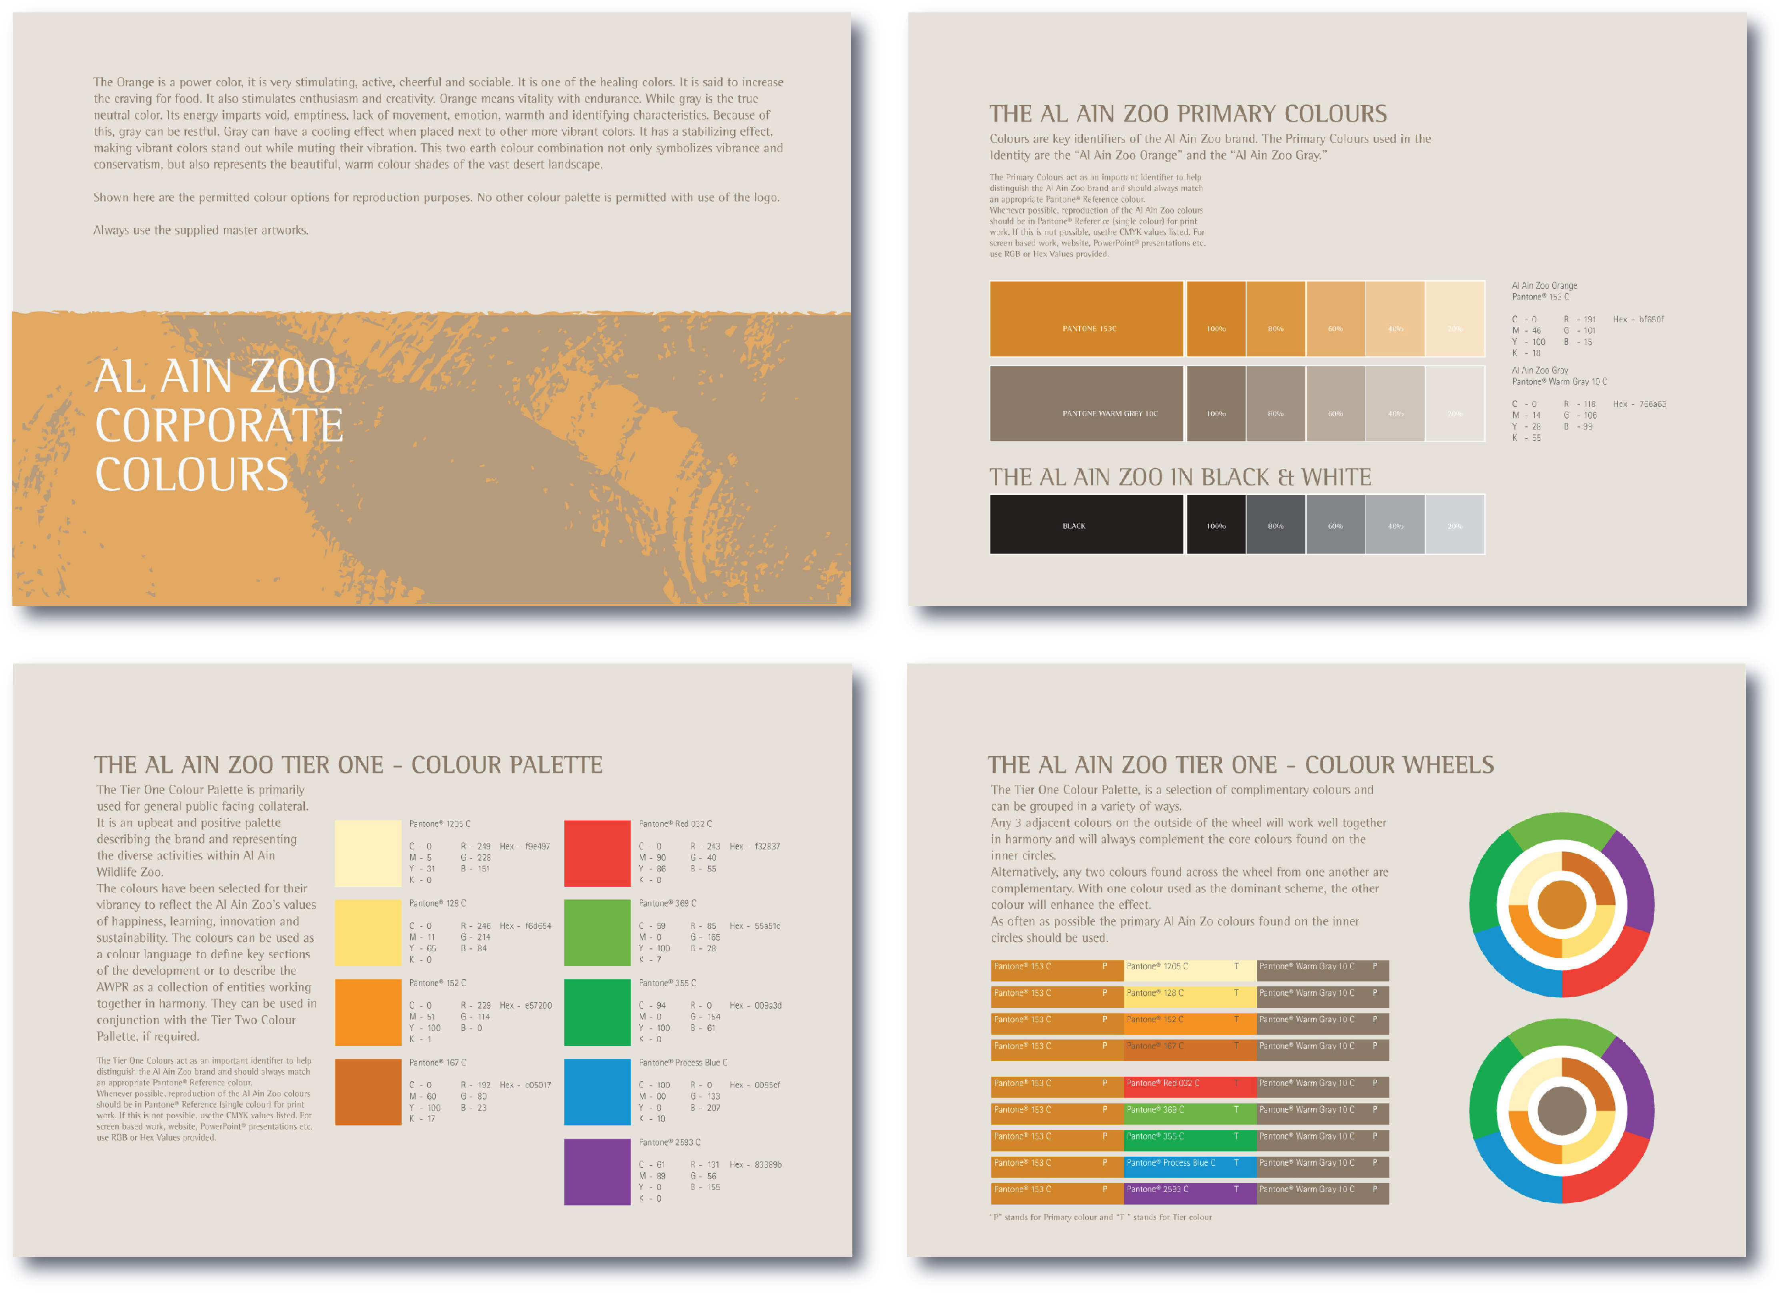

Slide 26
c.i. standards
lulu islands

Slide 29
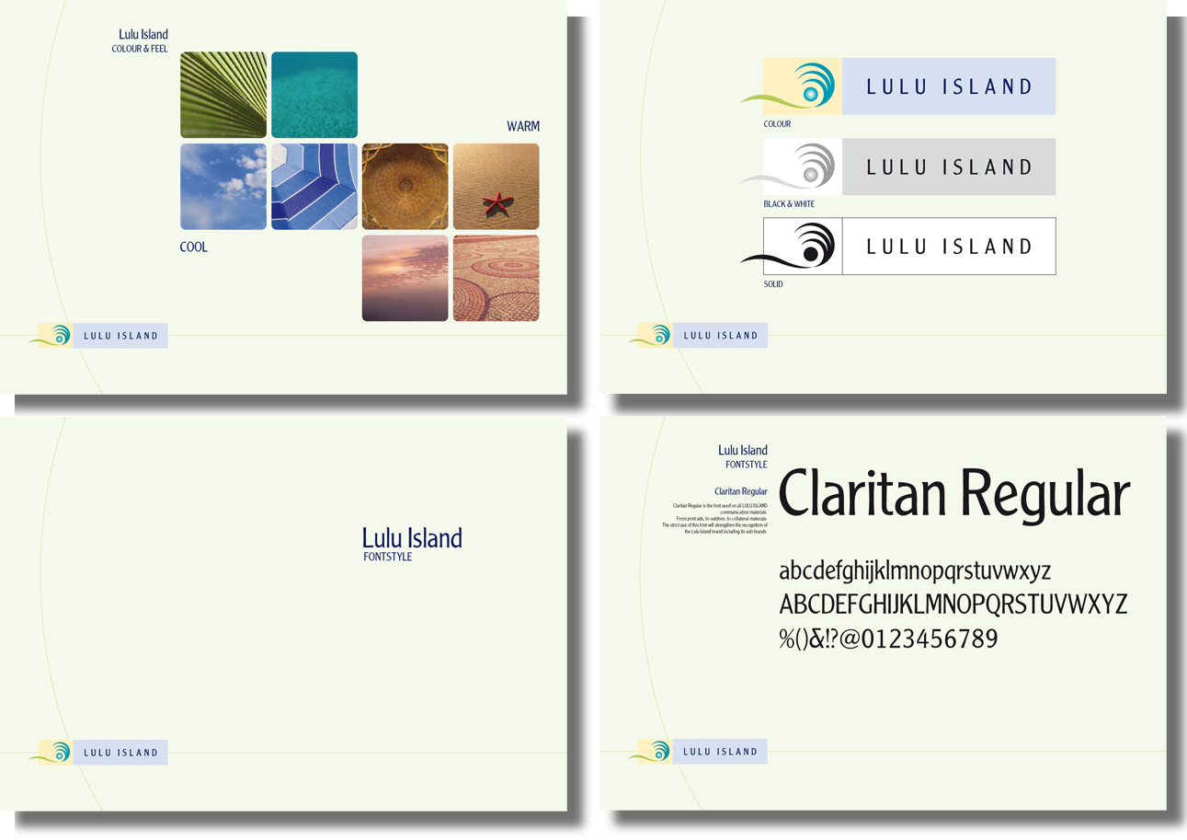

Slide 34
c.i. standards
wadi walk

Slide 35
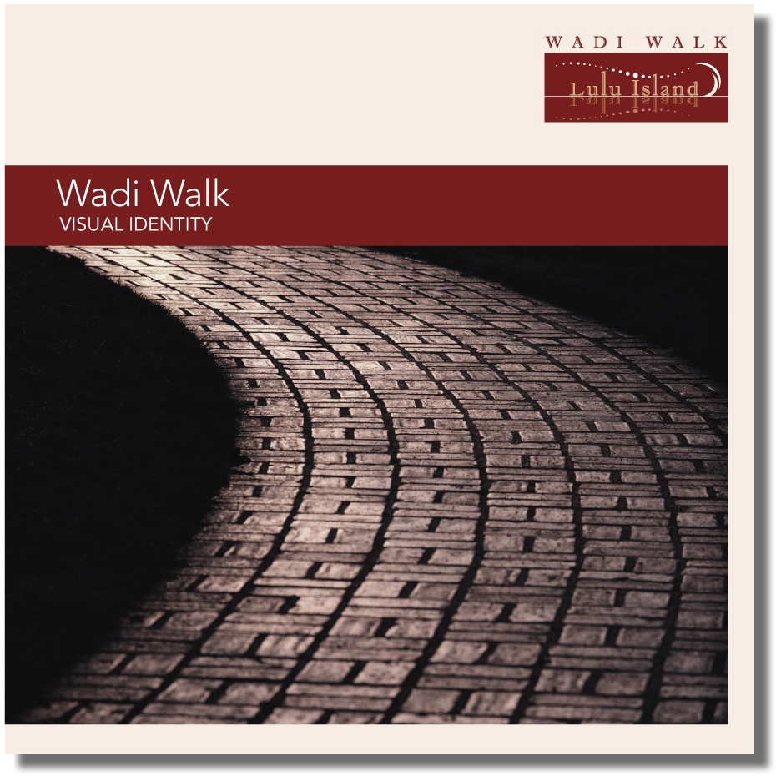

Slide 36
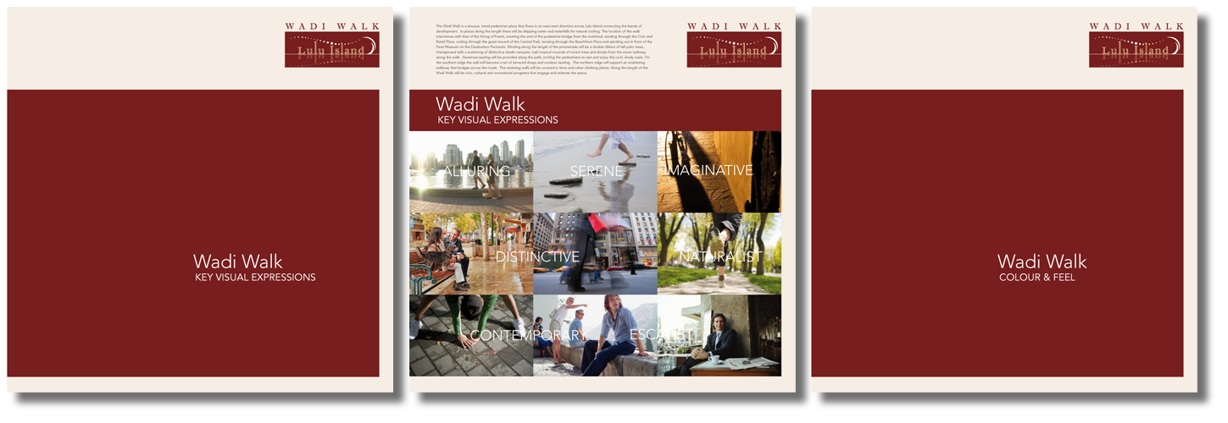

Slide 37
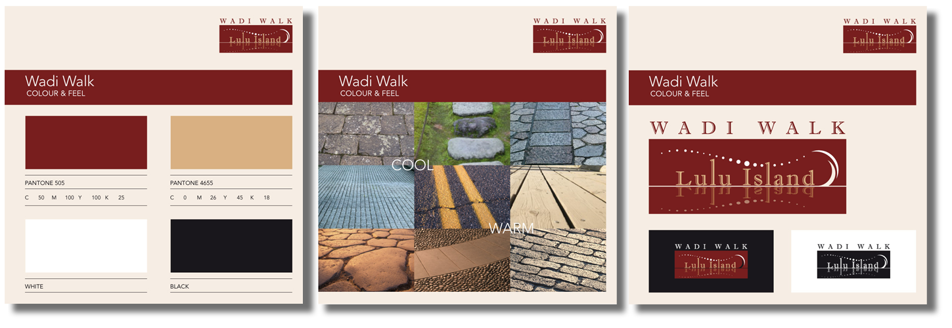

Slide 39
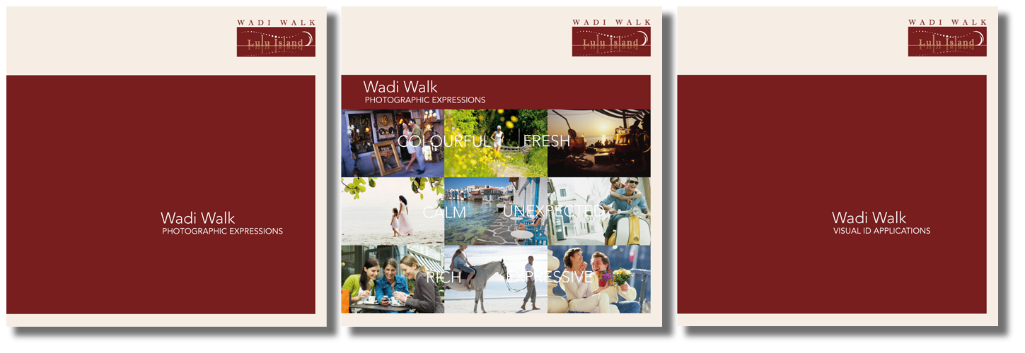

Slide 40
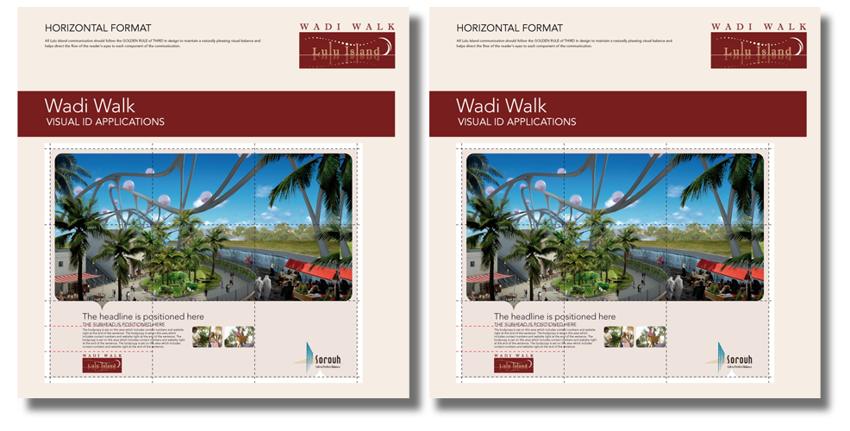

Slide 41
c.i. standards
Meydan

Slide 42
BROCHURE - DWC

Slide 43
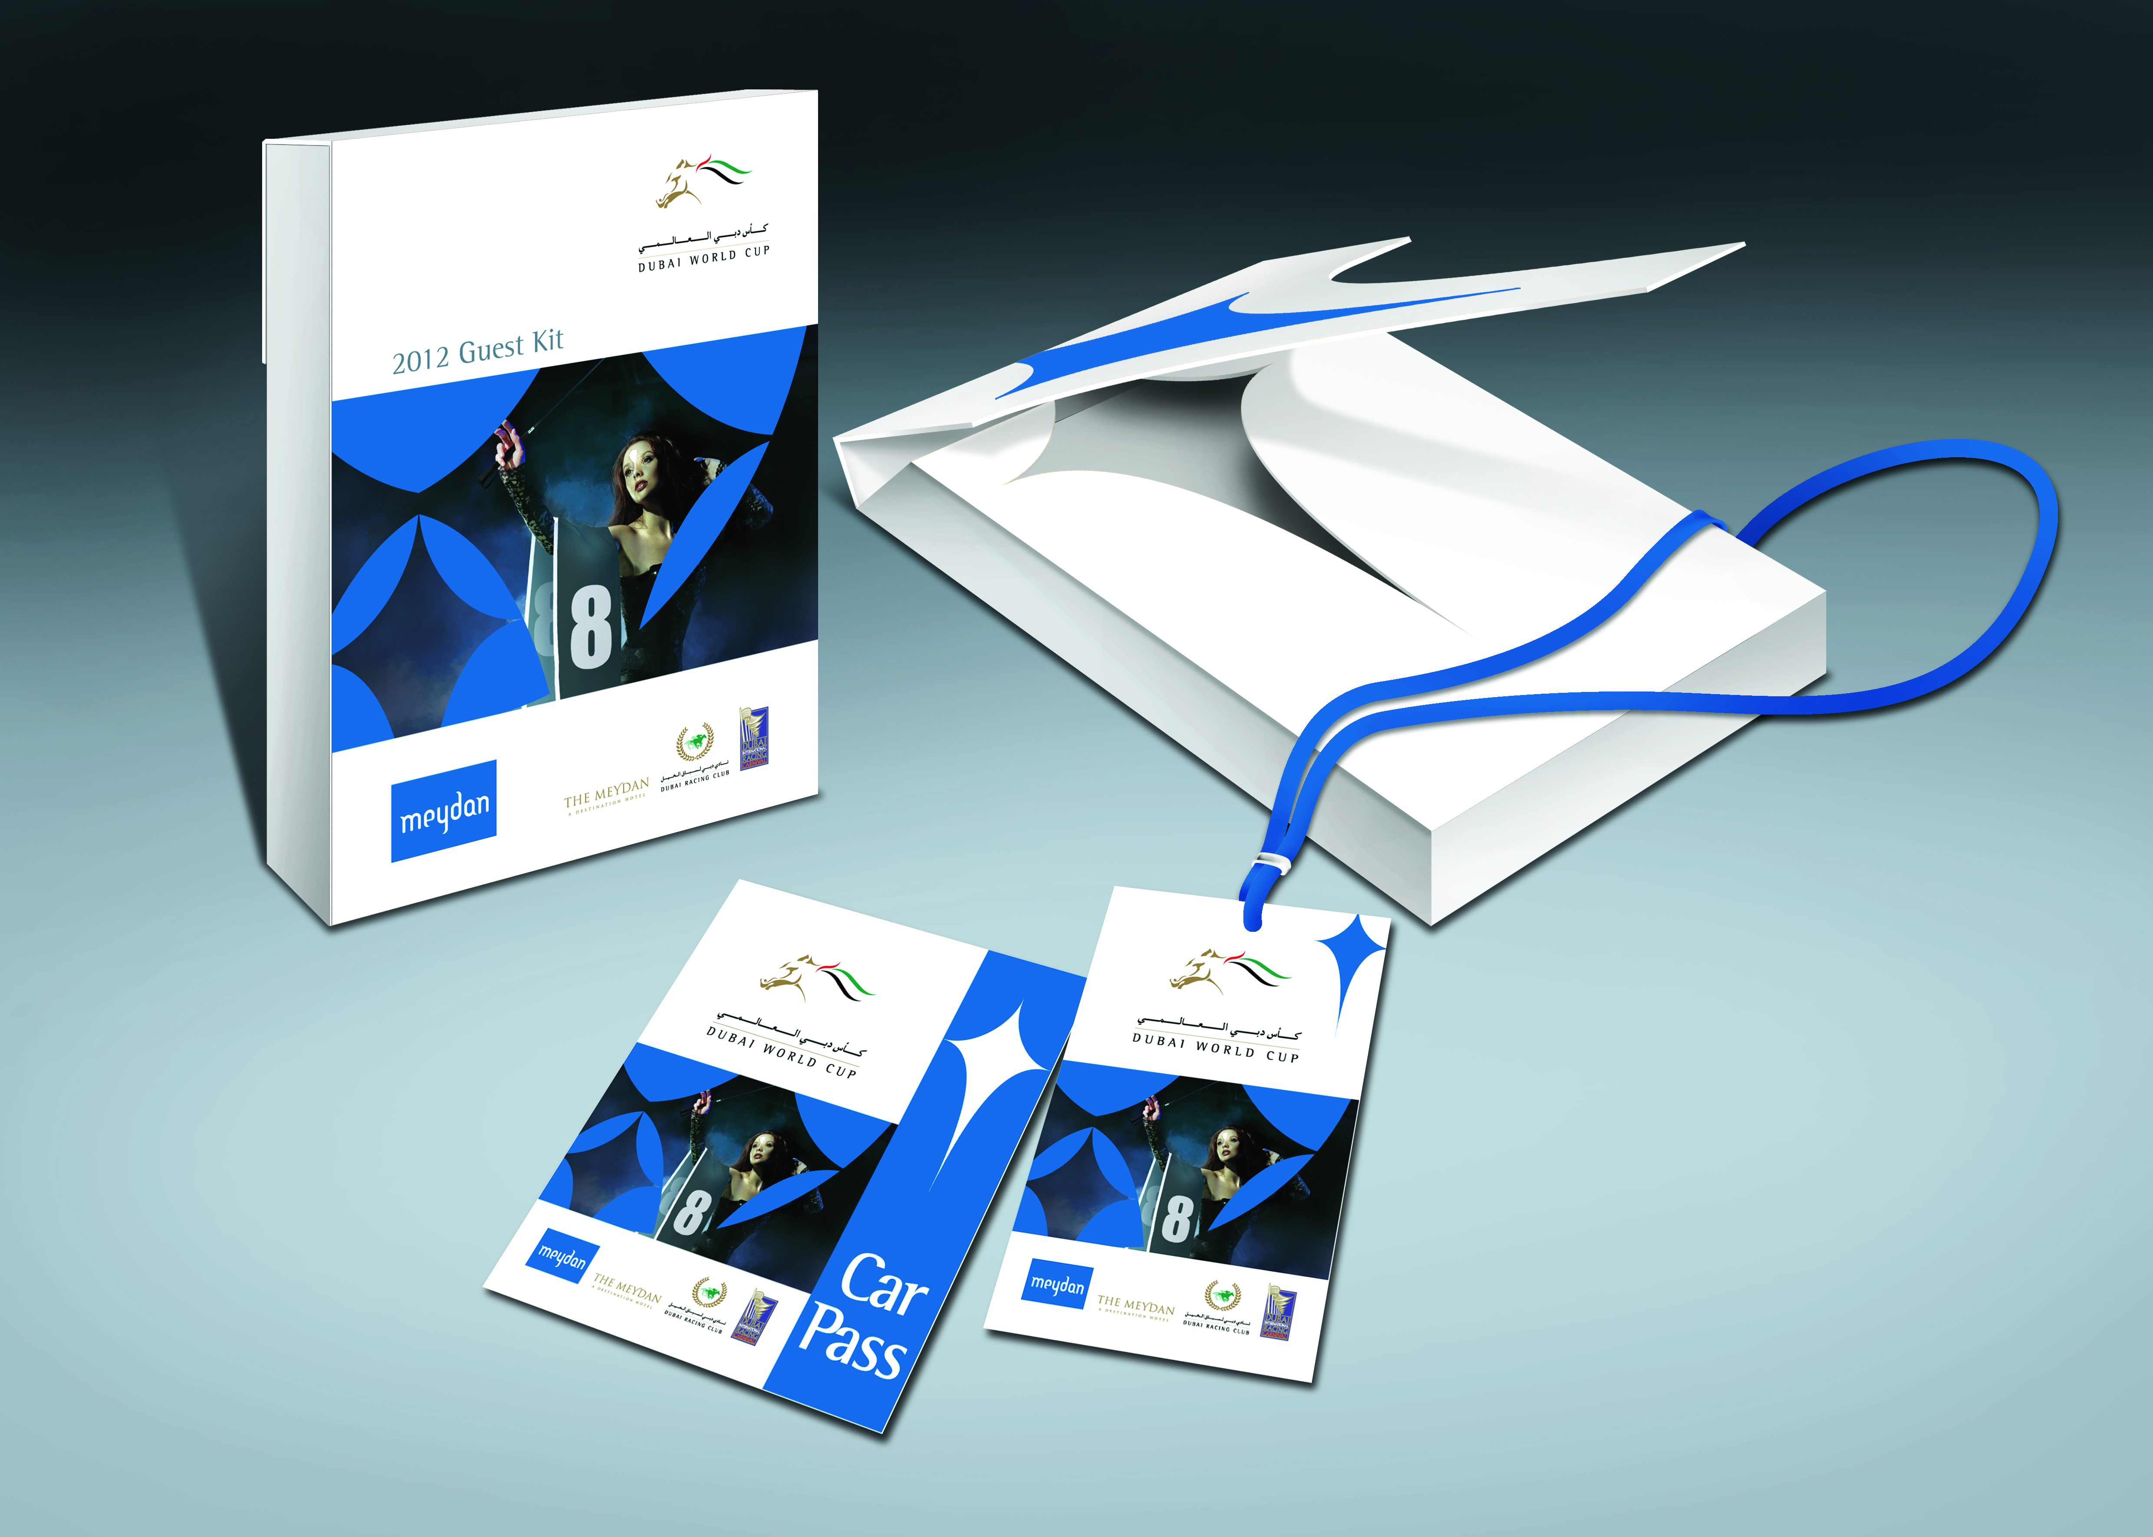
GUEST KIT BLUE - DWC

Slide 44
GUEST KIT SILVER - DWC

Slide 45
GUEST KIT GOLD - DWC

Slide 46
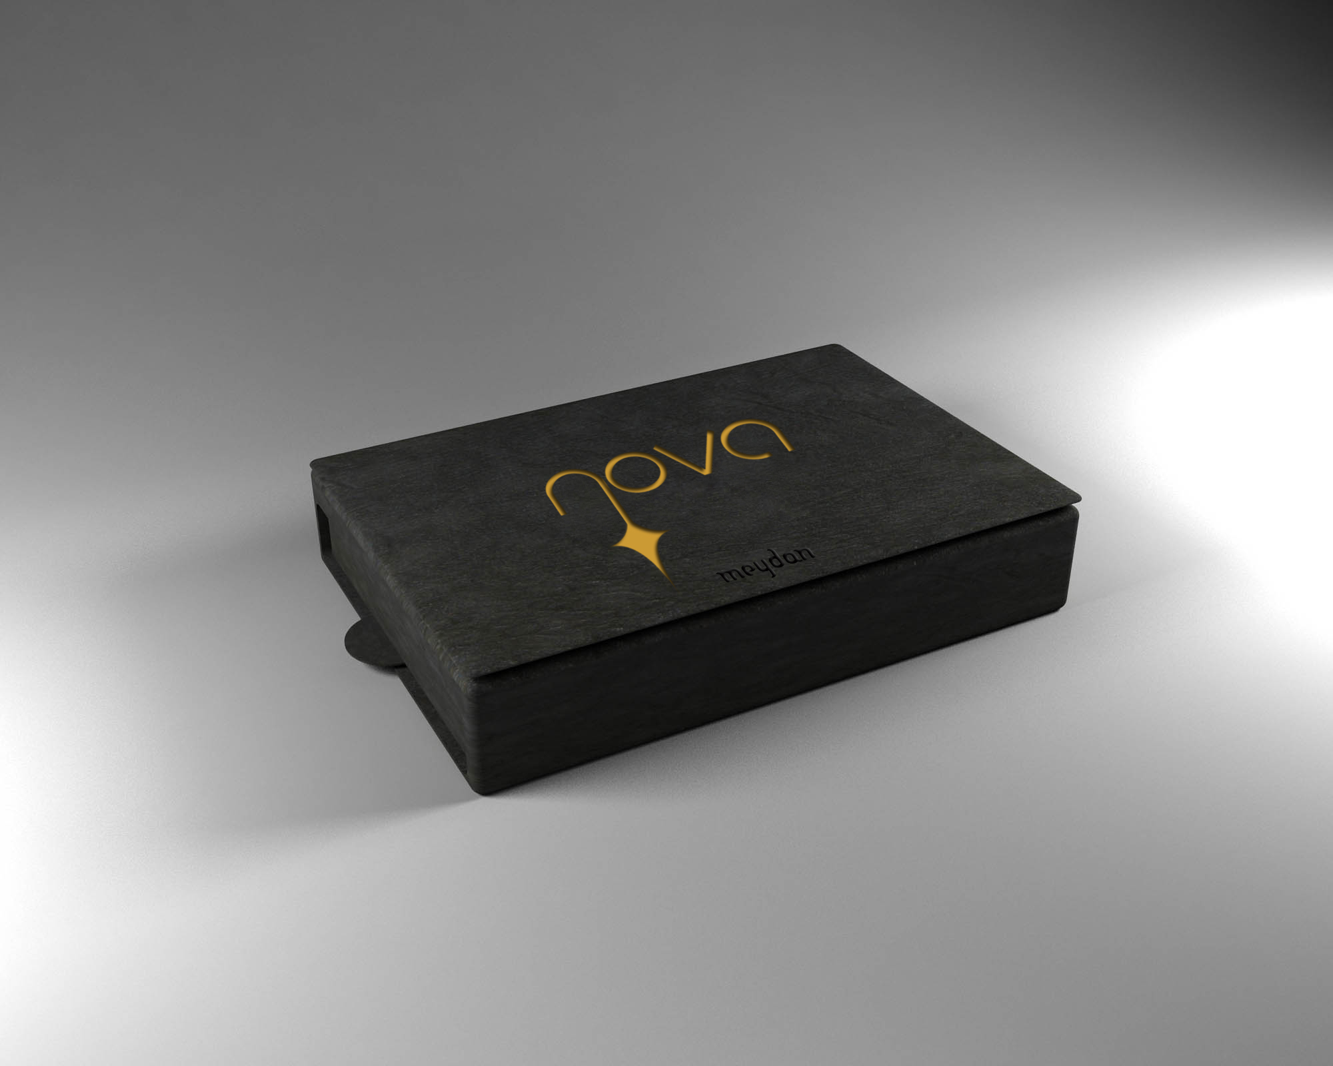

Slide 47
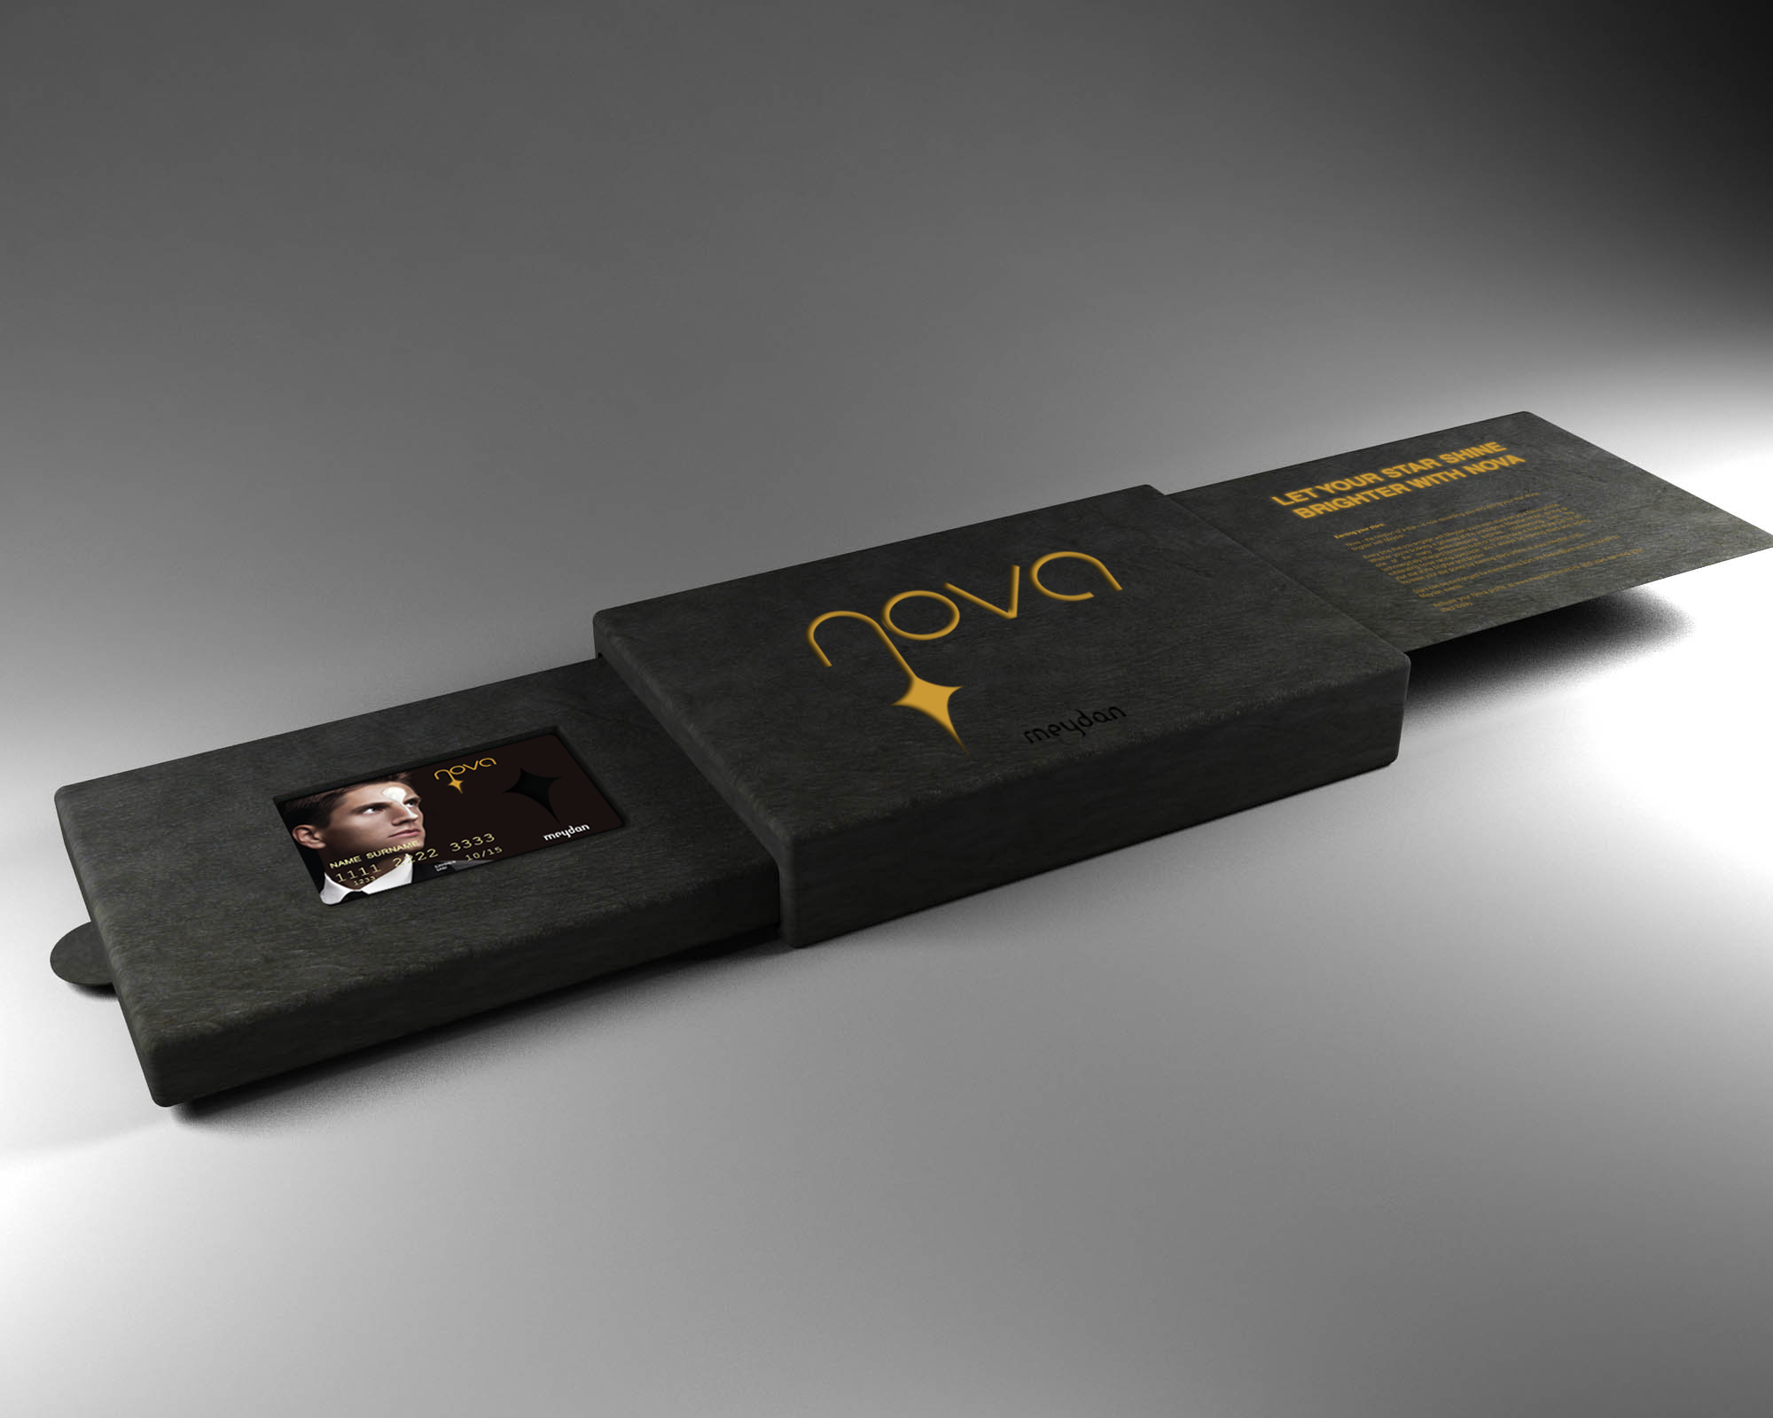

Slide 48
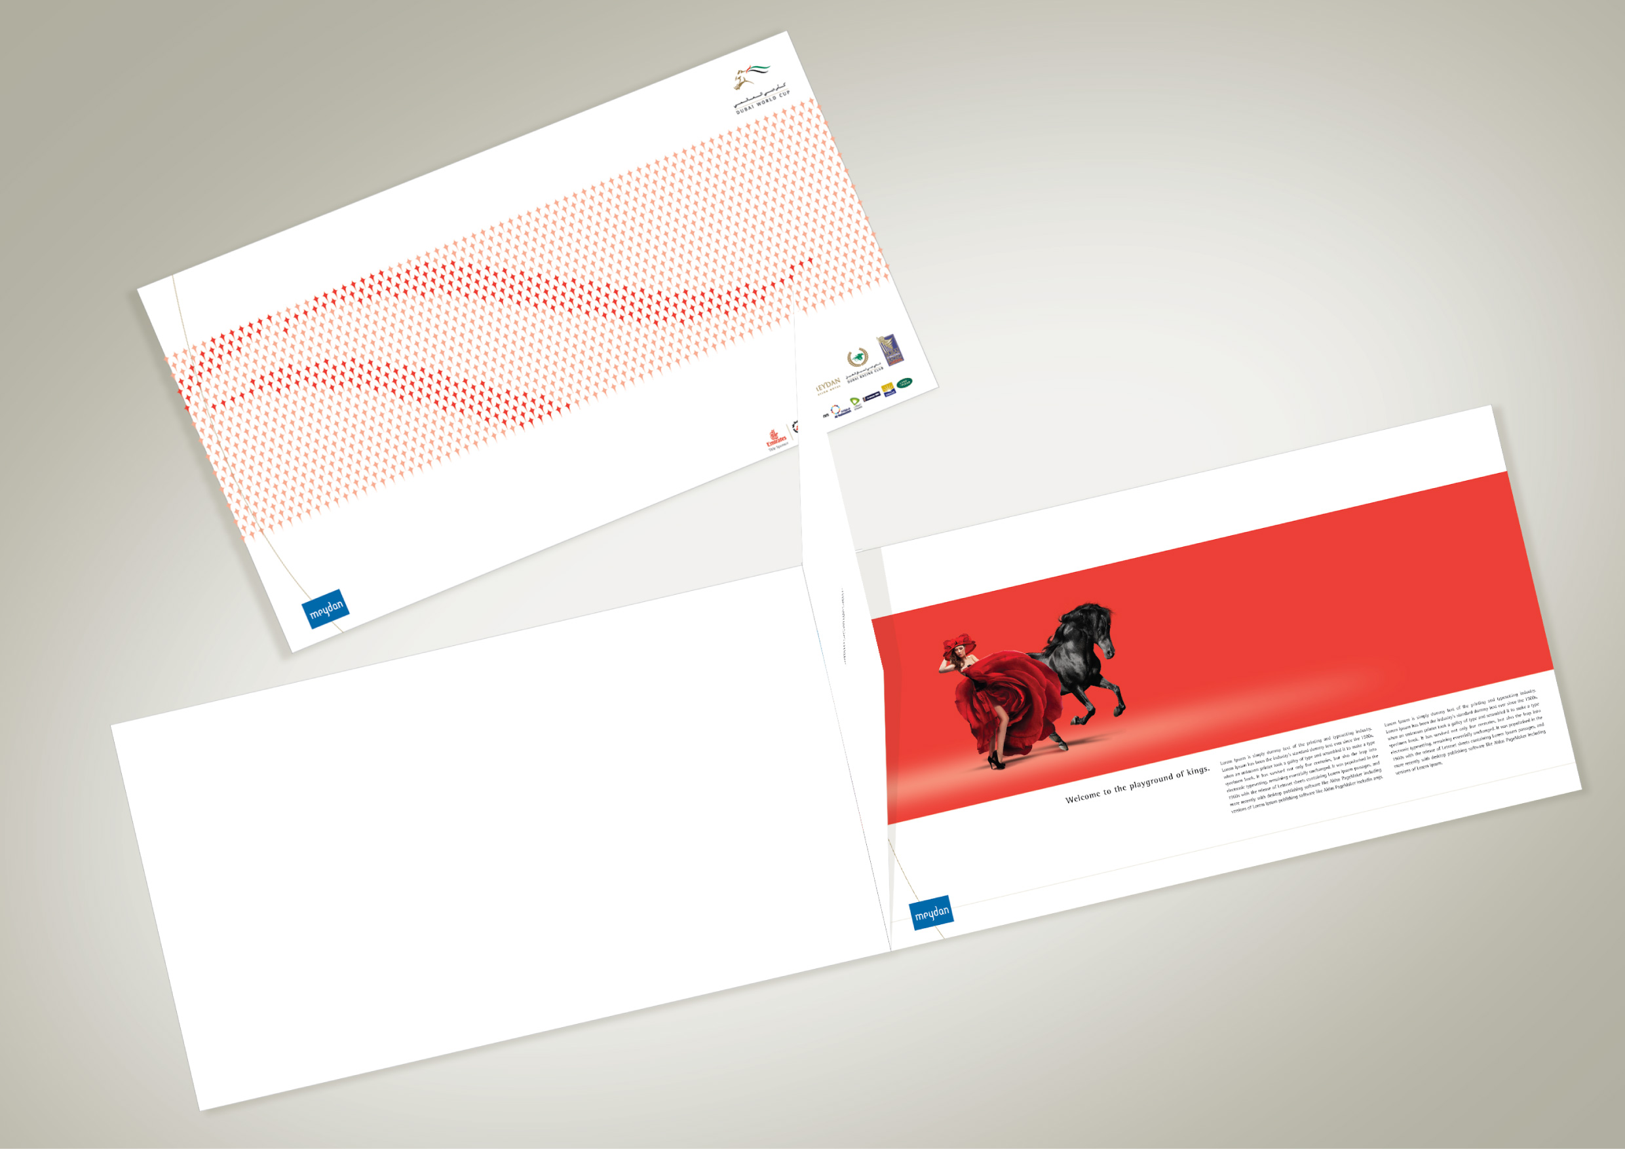
DWC - BOOKLET

Slide 49
DWC - Wallet

Slide 50
MICE – Grand Stand Brochure

Slide 51
logo design
basic logo designs

Slide 52
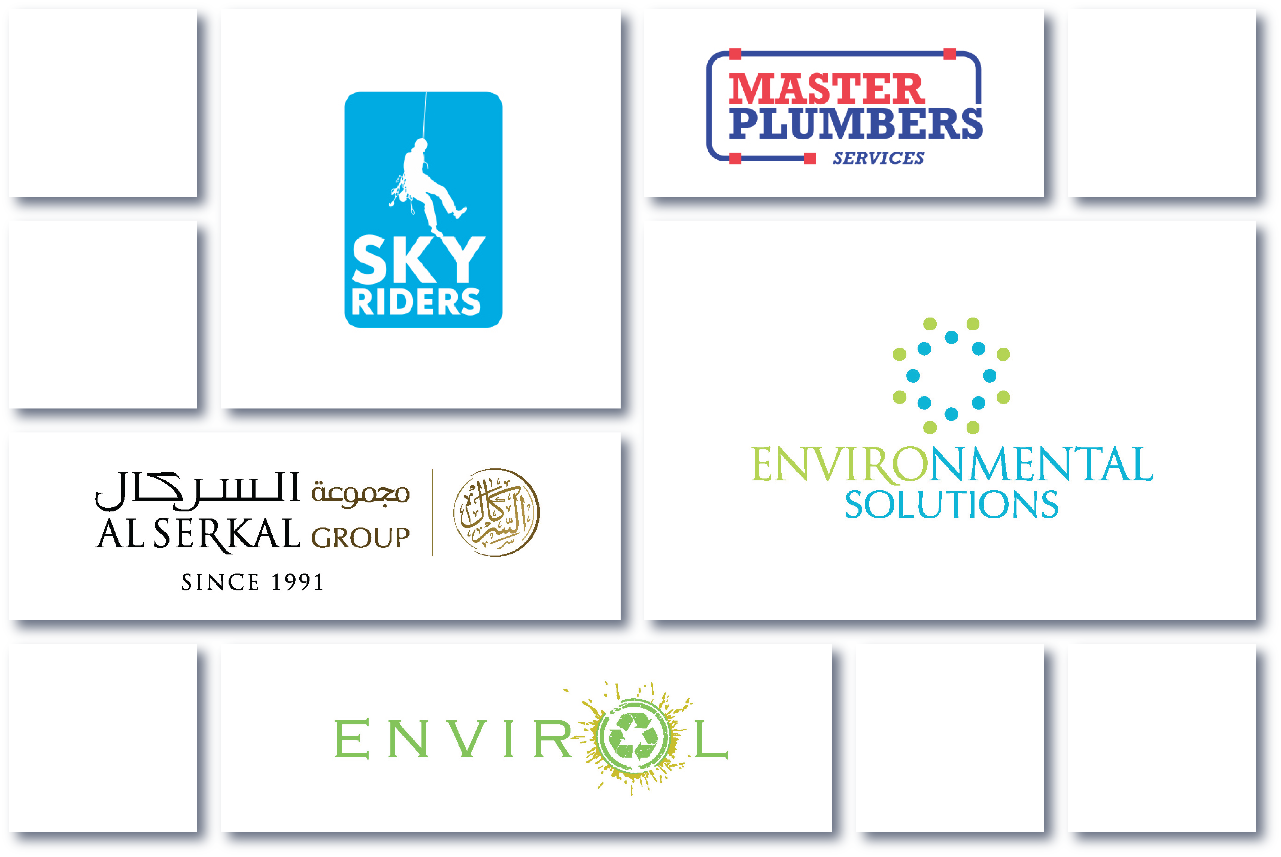

Slide 55
about this credential
This credential is the result of AGA's desire to improve the branding design experience of our partners/clients.
Our aim is to provide them with an inspiration that demonstrates a brand-centered design philosophy - to its implementation in various forms of communication & media. This document is still
evolving, and we welcome your feedback.
Please send us comments and suggestions to:
edan.dubai@aga-adk.com
We thank the many people behind the development of this
guide who share the same passion for the beauty of branding,
its discipline and its intricacies.

Slide 56
thank you!

